Slide 1
Normalization
-Bottom up approach

Slide 2
What is Normalization?
Database design may have some amount of
  Inconsistency
  Uncertainty
  Redundancy
To eliminate these drawbacks some refinement has to be done on the
database. This Refinement process is called Normalization.

Slide 3
Normalization
  It is Defined as a step-by-step process of decomposing a complex relation into a simple and stable data structure.
  It is a formal process that can be followed to achieve a good database design
  Also used to check that an existing design is of good quality
  The different stages of normalization are known as “Normal Forms”
  To accomplish normalization we need to understand the concept of Functional Dependencies.

Slide 4
Functional dependency
In a given relation R, X and Y are attributes. Attribute Y is functionally dependent on attribute X if each value of X determines EXACTLY ONE value of Y, which is represented as X -> Y (X can be composite in nature).
We say here “x determines y” or “y is functionally dependent on x”
X→Y does not imply Y→X
If the value of an attribute “Marks” is known then the value of an attribute “Grade” is determined since Marks→ Grade

Slide 5
Functional dependency
Types of functional dependencies:
  Full Functional dependency
  Partial Functional dependency
  Transitive dependency

Slide 6
Functional Dependencies
Consider the following Relation
REPORT (STUDENT#,COURSE#, StudentName,CourseName, Marks, Grade)
Description of the Attributes:
STUDENT# - Student Number
COURSE# - Course Number
StudentName- Student Name
CourseName - Course Name
Marks - Scored in Course COURSE# by Student STUDENT#
Grade - obtained by Student STUDENT# in Course COURSE#

Slide 7
Functional Dependencies- From the previous example
For each value of (Student# ,Course#), Marks obtained will be exactly one value. So we observe the following Functional dependency
STUDENT# COURSE# → Marks
For each value of Course# the name of the course will be exactly one value. So we observe the following Functional dependency
COURSE# → CourseName,
For each value of Marks the grade will be exactly one value. So we observe the following functional dependency
Marks → Grade

Slide 8
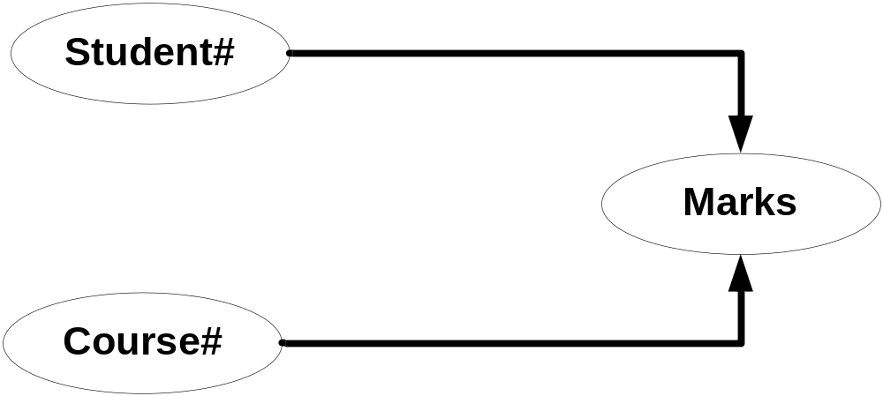
Full dependencies
X and Y are attributes.
X Functionally determines Y
Note: Subset of X should not functionally determine Y
Notes:
In above example Marks is fully functionally dependent on STUDENT# COURSE# and not on sub set of STUDENT# COURSE#. This means Marks can not be determined either by STUDENT# OR COURSE# alone. It can be determined only using STUDENT# AND COURSE# together. Hence Marks is fully functionally dependent on STUDENT# COURSE#.

Slide 9
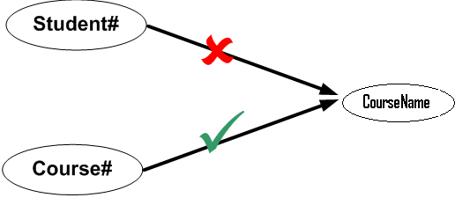
Partial dependencies
X and Y are attributes.
Attribute Y is partially dependent on the attribute X only if it is dependent on a sub-set of attribute X.
We have both the functional dependency valid in our example
Student# Course# CourseName
Course# CourseName
So we can say that CourseName is partially dependent on Student# Course#
Notes:
CourseName is not fully functionally dependent on STUDENT# COURSE# because subset of STUDENT# COURSE# i.e only COURSE# determines the CourseName and STUDENT# does not have any role in deciding CourseName. Hence CourseName is not fully functionally dependent on STUDENT# COURSE#.
In the above relationship CourseName is partially dependent on composite attributes STUDENT# COURSE# because COURSE# alone defines the CourseName.

Slide 10

Transitive dependencies
X Y and Z are three attributes.
X -> Y
Y-> Z
=> X -> Z
Notes:
In above example, Grade depends on Marks and in turn Marks depends on Student#COURSE#. Hence Grade transitively depends on Student#COURSE#.
Transitive: Indirect

Slide 11

Need for Normalization
Lets observe the Online Retail Application Table
Each row of the table Represents the information of a customer who has purchased an item.

Slide 12
Need for Normalization
In this Scenario
  Can we Insert the record of an item which has not been purchased by any customer?
  Can we delete the record of item which has been purchased by only one customer?
  How many rows we need to update if there is a change in description of item?
  How many times we need to store the description of an item if the same item is purchased many times?
So we observe the following in the Un Normalized table:
Insert , Delete, Update Anomaly
Data Duplication
The table is not to maintain the record of items but it is to keep the record of purchase of item by customers
There will be information Loss for that item
Depends upon the no of times the item has been purchased
Depends upon the no of times the item has been purchased

Slide 13
Need for Normalization
So we observe the following in the Un Normalized table:
Insert , Delete, Update Anomaly
Data Duplication

Slide 14
First Normal Form: 1NF
A relation schema is in 1NF :
  if and only if all the attributes of the relation R are atomic in nature.
  Atomic: the smallest level to which data may be broken down and remain meaningful
Notes:
In relational database design it is not practically possible to have a table which is not in 1NF.

Slide 15

Online Retail Application Tables – 1NF Normalized
Observation on Un Normalized Retail Application Table
Customerdetails, Itemdetails and PurchaseDetails are composite
Above observation violates 1NF definition
To bring it to 1NF we need to make the columns atomic

Slide 16
R(A, B, C, D, E),
FD={A->B, B->C, C->D}

Slide 17
Second Normal Form: 2NF
A Relation is said to be in Second Normal Form if and only if :
  It is in the First normal form, and
  No partial dependency exists in the relation.
Partial Dependency = Proper subset of Candidate Key -> Non Prime Attribute
To make a table 2NF compliant, we have to remove all the partial dependencies

Slide 18
Second Normal Form : Example
Functional Dependencies of Retail Application Table
RetailApplicationTable( CustomerId, ItemId, CustomerName, AccountNo,ItemName, UnitPrice, Class,QtyPurchased, NetAmount)
(i) CustomerId → CustName, AccountNo
(ii) ItemId → ItemName, UnitPrice, Class
(iii) CustId,ItemId →QtyPurchased, NetPrice
(iv) UnitPrice→Class

Slide 19
Second Normal Form : Example (Cont..)
Key and Non Key Attributes of Retail Application Table
{CustomerId, ItemId} is Candidate key
Key Attributes: CustomerId,ItemId
Non Key Attribures: CustomerName,
AccountNo,
ItemName,
UnitPrice,
Class,
QtyPurchased,
NetAmount

Slide 20
Second Normal Form : Example (Cont..)
Fully Functionally dependent on Key Attribute
CustomerId, ItemId
QtyPurchased, NetPrice
Partial Dependency with respect to Key Attribute
CustomerId
CustomerName,AccountNo,BankName
ItemId
ItemName,UnitPrice,Class
No Dependency with respect to Key Attribute
UnitPrice
Class

Slide 21

Second Normal Form : Example (Cont..)
After removing the Partial dependencies on Key Attributes we get the below tables which are in 2NF:
Customer
CustomerId | CustomerName | Accountno
1001 | John | 1500012351
1002 | Tom | 1200354611
1001 | John | 2134724532
Item
ItemId | ItemName | UnitPrice | Class
STN001 | Pen | 10 | A
BAK003 | Bread | 10 | A
GRO001 | Poteto | 20 | B

Slide 22
Second Normal Form : Example (Cont..)
ItemPurchase
CustomerId | ItemId | QtyPurchased | NetAmt
1001 | STN001 | 5 | 50
1002 | BAK003 | 1 | 10
1001 | GRO001 | 1 | 20

Slide 23
Third Normal Form: 3 NF
A relation R is said to be in the Third Normal Form (3NF) if and only if
  It is in 2NF and
  No transitive dependency exists between non prime attributes.
A
B
C
To make a table 3NF compliant, we have to remove all such Transitive Dependencies
Notes:
The definition given in the slide is specific to Key and Non-Key attributes.

Slide 24
Third Normal Form: 3 NF
A table is in 3NF if and only if for each of its non-trivial functional dependencies at least one of the following condition holds:
L.H.S. is S.K.
R.H.S. is Prime Attribute
Notes:
The definition given in the slide is specific to Key and Non-Key attributes.

Slide 25
Third Normal Form : Example
Let us consider Item table obtained after bringing Retail Application table in to 2NF:
ItemId
UnitPrice
UnitPrice
Class
ItemId
UnitPrice
Class
The above dependencies violates 3NF definition

Slide 26
Third Normal Form : Example (Cont..)
After removing the transitive dependencies from the Item table we get the following two table
Item
ItemId | ItemName | UnitPrice
STN001 | Pen | 10
BAK003 | Bread | 10
GRO001 | Poteto | 20
ItemClass
UnitPrice | Class
10 | A
20 | B

Slide 27
Boyce Normal Form (BCNF)
A relation is in BCNF iff
It is in 3NF
For each non-trivial FD X->Y, X must be super key

Slide 28
Merits of Normalization
Normalization is based on a mathematical foundation.
Removes the redundancy to a greater extent.
After 3NF, data redundancy is minimized to the extent of foreign keys.
Removes the anomalies present in INSERTs, UPDATEs and DELETEs.

Slide 29
Demerits of Normalization
Data retrieval or SELECT operation performance will be severely affected.
Normalization might not always represent real world scenarios.

Slide 30
Summary
Most of the application errors are because of miscommunication between the application user and the designer and between the designer and the developer.
It is always better to represent business findings in terms of picture to avoid miscommunication
It is practically impossible to review the complete requirement document by business users.
An E-R diagram is one of the many ways to represent business findings in pictorial format.
E-R Modeling will also help the database design
E-R modeling has some amount of inconsistency and anomalies associated with it.

Slide 31
Summary
Normalization is a refinement process. It helps in removing anomalies present in INSERTs/UPDATEs/DELETEs.
Normalization is also called “Bottom-up approach”, because this technique requires very minute details like every participating attribute and how it is dependant on the key attributes, is crucial. If you add new attributes after normalization, it may change the normal form itself.
There are four normal forms that were defined being commonly used.
1NF makes sure that all the attributes are atomic in nature.
2NF removes the partial dependency.

Slide 32
Summary – contd.
3NF removes the transitive dependency.
Too much of normalization adversely affects SELECT or RETRIEVAL operations.
It is always better to normalize to 3NF for INSERT, UPDATE and DELETE intensive (On-line transaction) systems.
It is always better to restrict to 2NF for SELECT intensive (Reporting) systems.
While normalizing, use common sense and don’t use the normal forms as absolute measures.

Slide 33
Thank You
“The contents of this document are proprietary and confidential to Infosys Technologies Ltd. and may not be disclosed in whole or in part at any time, to any third party without the prior written consent of
Infosys Technologies Ltd.”
“© 2008 Infosys Technologies Ltd. All rights reserved. Copyright in the whole and any part of this document belongs to Infosys Technologies Ltd. This work may not be used, sold, transferred, adapted, abridged, copied or reproduced in whole or in part, in any manner or form, or in any media, without the prior written consent of Infosys Technologies Ltd.”

